Slide 1
Web Engineering
CONTROLLERS
And
How to manage login system

Slide 2
Controllers
The controller - The coordinator that provides the link between the view and the model.
The controller is responsible for processing input, acting upon the model, and deciding on what action should be performed, such as rendering a view or redirecting to another page.
Continuing the blog example, the controller might look up the most recent comments for a post (the model) and pass them to the view for rendering.
Notes:
HTML ko zaida likhna na paray.

Slide 3
Laravel Controllers
In Laravel, all Controllers are store aap→Http→Controllers directory.
Laravel provides a base controller name Controller.php
All laravel controllers should extend the base controller.
Inside Controller folder, you can create further folders to better organize your controllers.
Notes:
HTML ko zaida likhna na paray.

Slide 4
Laravel Controllers
Open aap→Http→Controllers→Auth directory
Inside Auth folder, there is file name AuthController.php (this is an authentication controller, it authenticates existing user also handle registration of users)
Notes:
HTML ko zaida likhna na paray.

Slide 5
Laravel Controllers
We write most of the application logic in controllers. Controller is processing the data.
Application knows the route, it should go to controller first. Controller should determine needs to accomplish this task. If the need is go to database then it call or invoke the model.
Notes:
HTML ko zaida likhna na paray.

Slide 6
Laravel Controllers
Example: form validation, if we need to concatenate strings etc.. All kind of processing of data, logic of the data is defined in Controllers.
Notes:
HTML ko zaida likhna na paray.

Slide 7
Controller Creation
To create a controller open terminal cmd and write a command.
php artisan make:controller PagesController
This command will automatically create controller name PagesController in app→Http→Controllers
Notes:
HTML ko zaida likhna na paray.

Slide 8
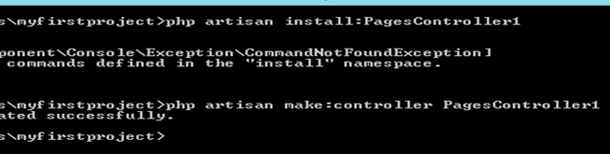

Slide 9
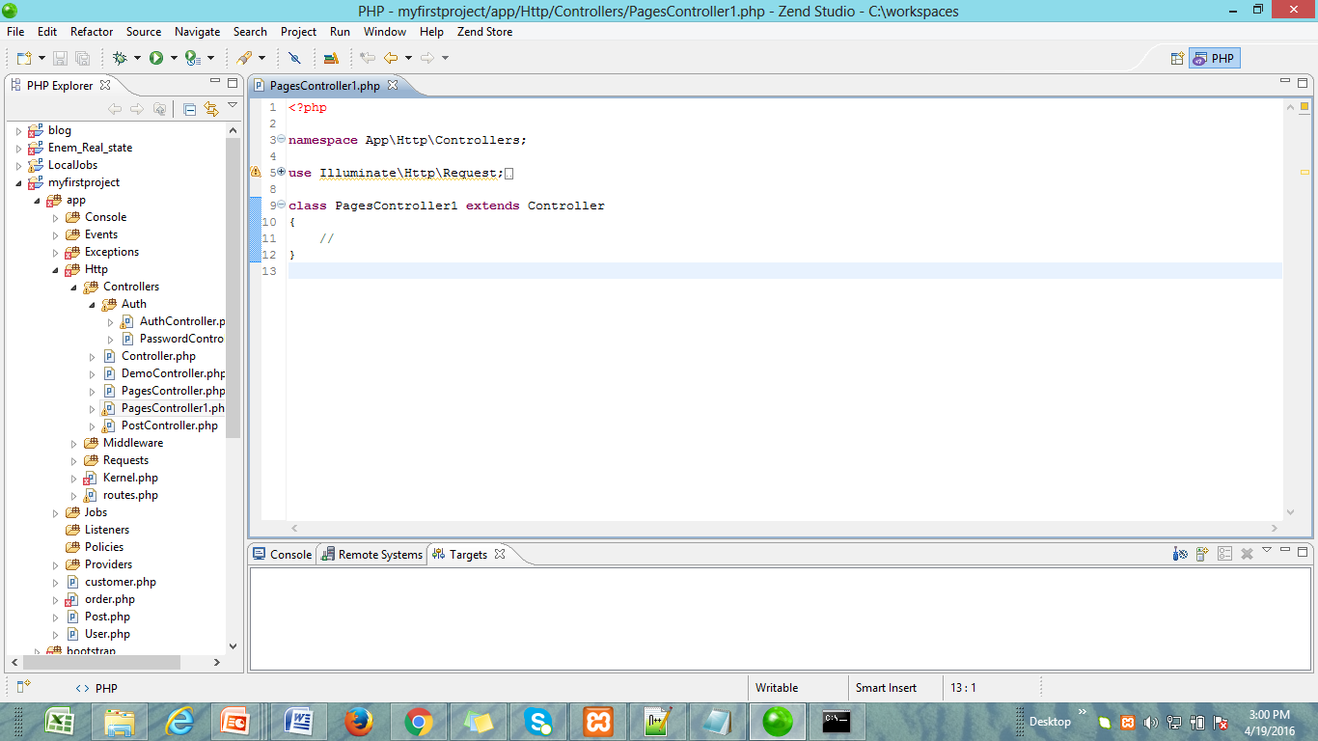

Slide 10
Controller Creation
I create PagesController, it handles all of our static pages.
Controller word should be at end of controller name starting with capital C.
You have namespace in all of your controllers.
Notes:
HTML ko zaida likhna na paray.

Slide 11
Namespace App
The root directory of a fresh laravel installation contains a variety of folders.
The App Directory: The “meat” of your application lives in the app directory. By default, this directory is namespaced under App and is autoloaded by composer.
The default, application namespace is App. However you may change this namespace.

Slide 12
Controller function
Inside Controller we define functions.
The name of our function start with action get, post, put or delete. So, we create function getIndex()
After that tell the route to point to this Controller, and use these actions on Controllers to process our data.
Route::get(‘contact’, ‘PagesController@getContact’);
Notes:
HTML ko zaida likhna na paray.

Slide 13
Controller function
Now inside PagesController define three functions
<?php
namespace App\Http\Controllers;
class PagesController extends Controller{
public function getIndex(){
}
public function getAbout(){
}
public function getContact(){
}
}
Notes:
HTML ko zaida likhna na paray.

Slide 14
getIndex()
public function getIndex() {
return view(‘pages/welcome’);
return view(‘pages.welcome’);
}
Its better to use (.), its more object oriented.
This function will call the welcome.blade.php page which is store in pages folder inside view folder.
Notes:
HTML ko zaida likhna na paray.

Slide 15
getAbout()
Passing data from controllers to view. The task is to get first name and last name, and then passes that full name into views.
public function getAbout() {
$first = “Alex”;
$last = “John”;
$full = $first . “ ” . $last;
return view(‘pages.about’)→with(“fullname”, “$full”);
}
Notes:
HTML ko zaida likhna na paray.

Slide 16
With()
With() method, it takes two arguments. The first argument is the name, you want to access the variable in the view, in this case i am calling it fullname. The second argument is variable that we describe in the function that contain the actual name.
with(“fullname”, “full”);
Now open resource→views→pages→about.blade.php and insert this variable {{ $fullname }} to access the value of the variable.
Notes:
HTML ko zaida likhna na paray.

Slide 17
Passing Data
There is another easier way, to pass data to our views from controllers.
return view('pages.about')→withFullname($full);
We have capital letter F, so we do not need to separate function with variable. But the variable fullname in view will always start with lower case.
Notes:
HTML ko zaida likhna na paray.

Slide 18
Passing an Array
Pass it an array to view.
public function getAbout() {
$first = "Alex";
$last = "Doe";
$full = $first . " " . $last;
$email = "alex.doe@gmail.com";
$data = []; // empty array
$data['email'] = $email;
$data['fullname'] = $full;
return view('pages.about')->withData($data);
}
Notes:
HTML ko zaida likhna na paray.

Slide 19
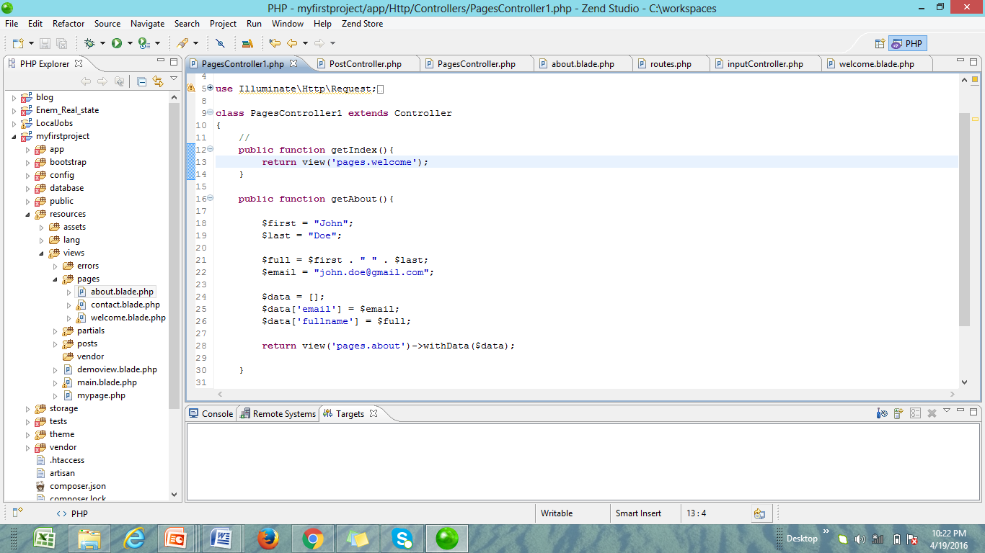

Slide 20
Passing an Array
Now open resource→views→pages→about.blade.php and enter code given below to get this data on view.
<div>About: {{ $data[‘fullname’] }} </div>
<p>Email me at: {{ $data[‘email’] }}</p>
Notes:
HTML ko zaida likhna na paray.

Slide 21
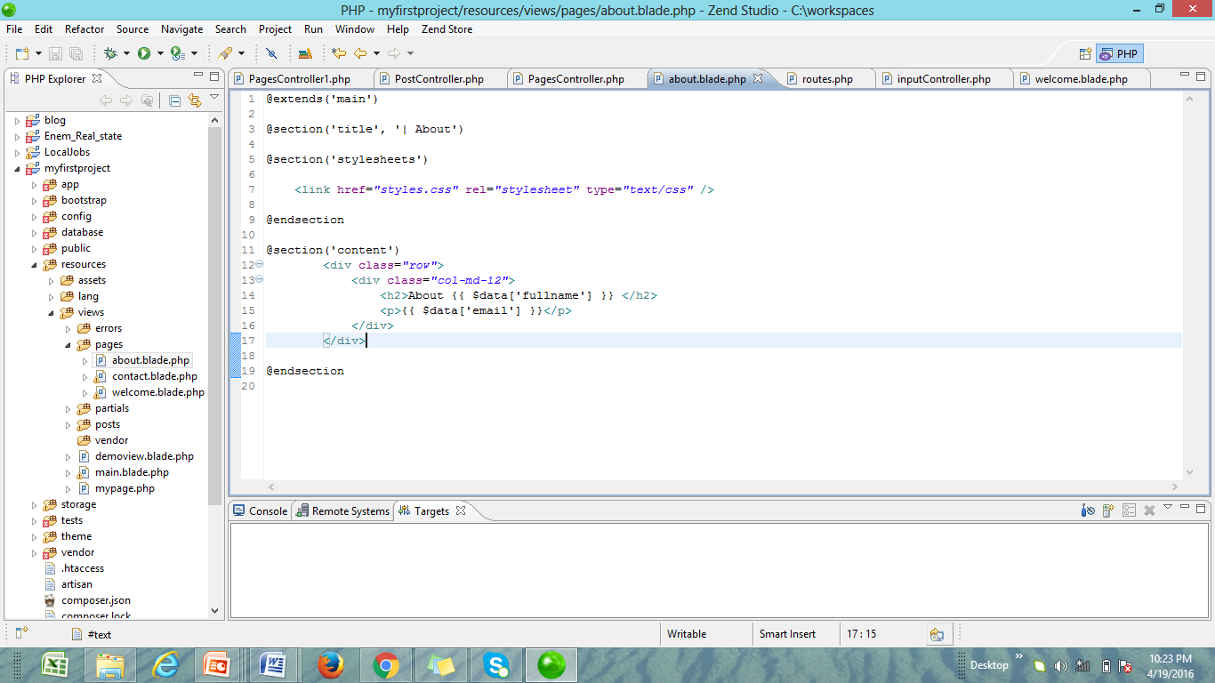

Slide 22
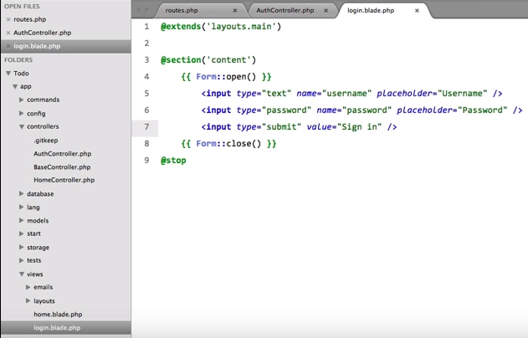

Slide 23
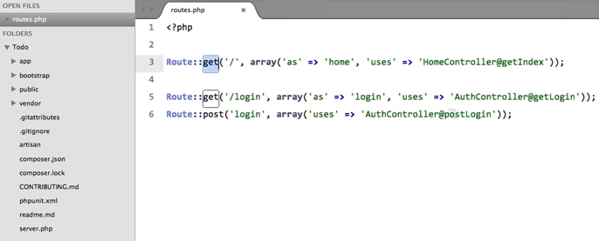

Slide 24
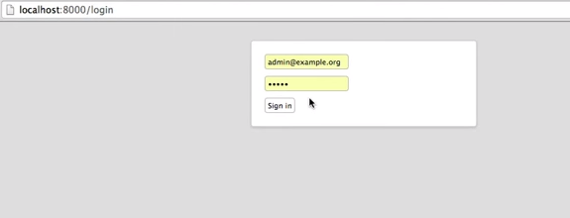

Slide 25
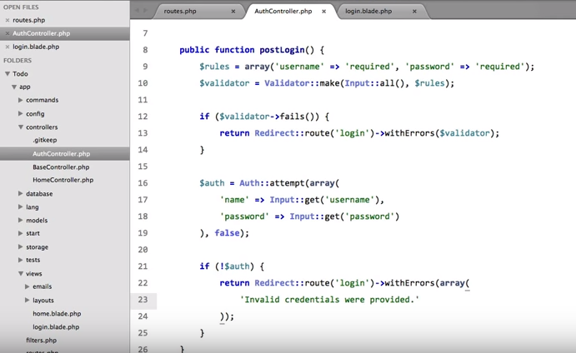

Slide 26
